Slide 1

Phonetic drill
to use in English lessons while learning English sounds
(for 1-4 forms)

Slide 2
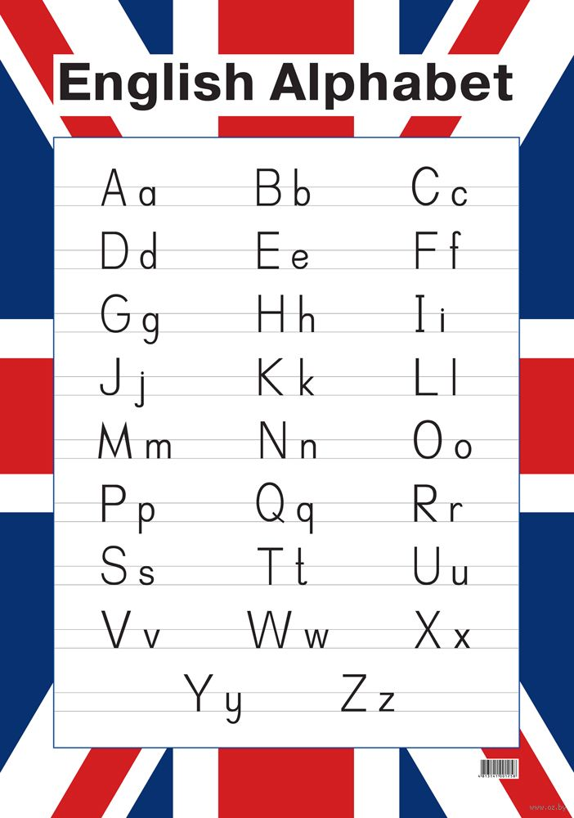
In English
26 letters
44 sounds
Consonants:
[b,p,d,t,g,k,v,f,s,z,θ, ð, h, l, m, n, ŋ, r, w, j, ʃ, tʃ, dʒ, ʒ]
***
Vowels
[ɔ ,ɔ:, u, u:,a:, ʌ, æ, i, i:, e, ə, ə:]
[ai],[oi],[ei],[au],[ou],[uə],[iə],[eə]

Slide 3
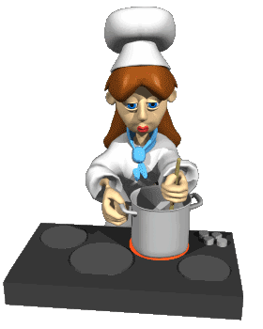
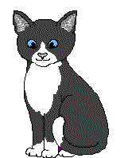

Part I
Monophthongs Aa
[æ]
A black cat sat on a mat
and ate a fat rat.
[ei]
Kate bakes tasty cakes.

Slide 4
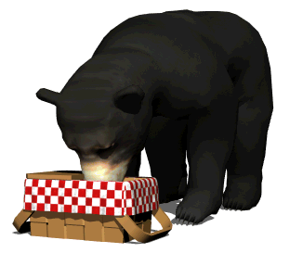
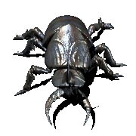
Bb
[b]
A big black bug bit a big black bear,
a big black bear bit a big black bug.

Slide 5
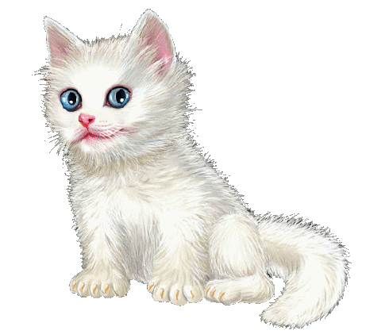

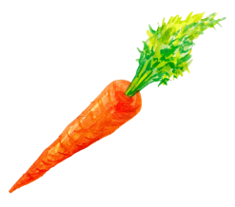
Cc
[s]
The city mice are dancing
in a circle.
[k]
Can a cat catch a carrot
on a carpet ?

Slide 6


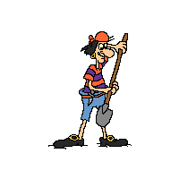
Dd
[d]
Draw drowsy ducks and drakes.
Dick dug a deep pit in the garden.

Slide 7



Ee
[e]
Every day in every way
the weather is getting
better and better.
[i:],[i]
Make tea for three,
please, for Jean, Steve
and me.

Slide 8


Ff
[f]
Four fine fresh fish are for you.
***
A fat fish has a fat fin.

Slide 9
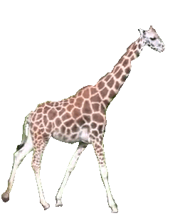
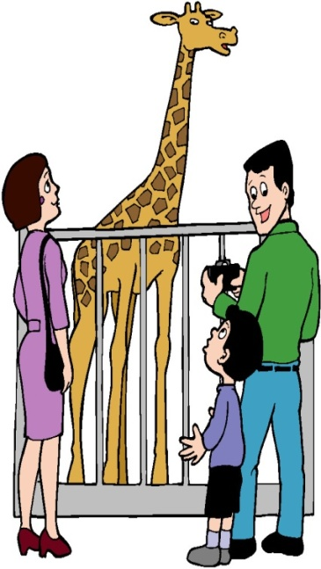
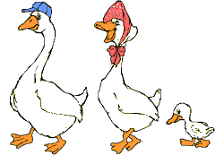
Gg
[g]
Giggling geese are playing
games.
They are going to race.
[dʒ]
George! Don’t give the
giraffes gingerbread

Slide 10


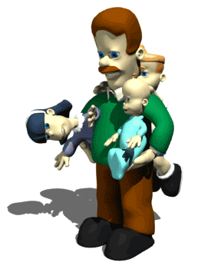

Hh
[h]
He has a hat in his hand.
Her husband hates hot tea.

Slide 11



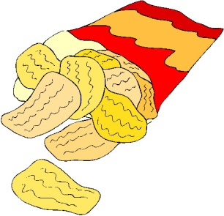
Ii
[ai]
I like white mice
They are very nice.
[i]
Give the pigs six big
chips.

Slide 12

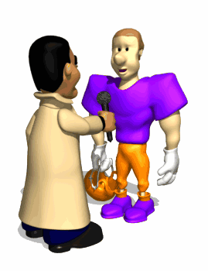
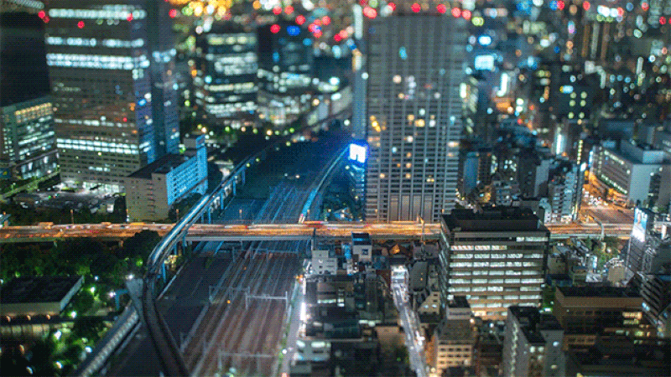
Jj
[ʤ]
A journalist made a journey over Japan.

Slide 13
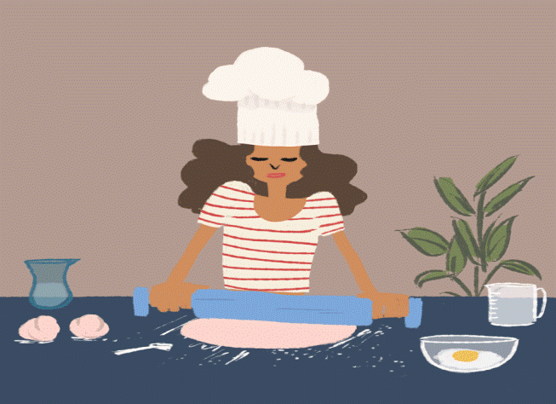
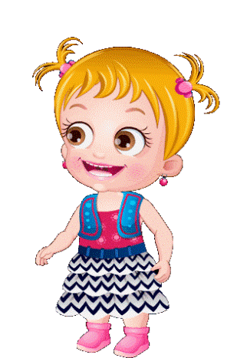
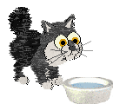
Kk
[k]
Kate cooks cakes in the kitchen.
Kitty caught the kitten in the kitchen.

Slide 14
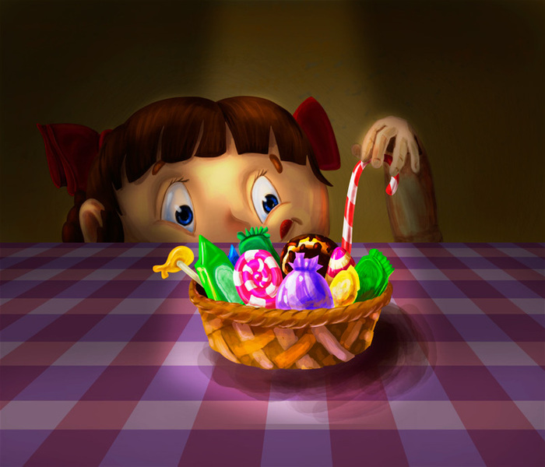

Ll
[l]
Little Lucy likes lollipops.

Slide 15
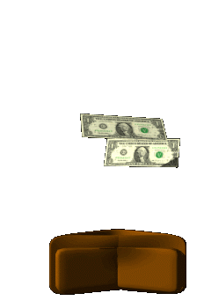

Mm
[m]
Mike made much money working as a mechanic.

Slide 16
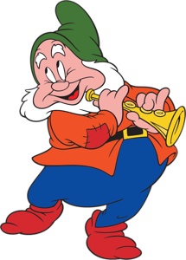

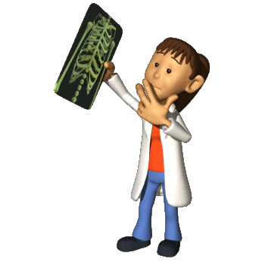
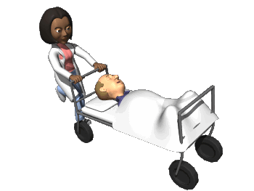
Nn
[n]
No nose knows like a gnome’s nose knows.
Nine nice night nurses nursing nicely.

Slide 17


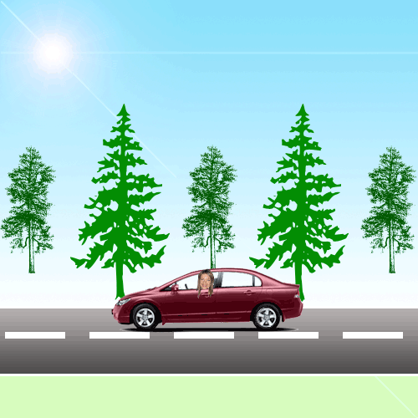

Oo
[ou]
Don’t go home alone
nobody knows how lonely
the road is.
[ɔ]
Clock, clock, clock,
A dog plays with the
frog
The frog plays with the
dog
Clock, clock, clock.

Slide 18
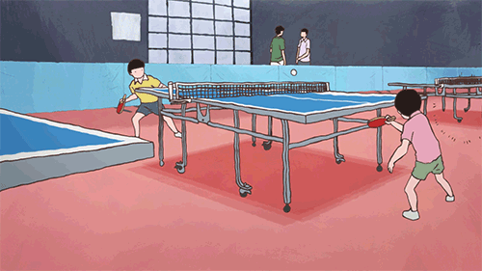
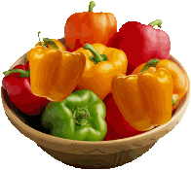
Pp
[p]
Ping-pong is a popular
sport game.
Peter Piper picked a peck of
pickled peppers, a peck of
pickled peppers Peter Piper
picked.

Slide 19
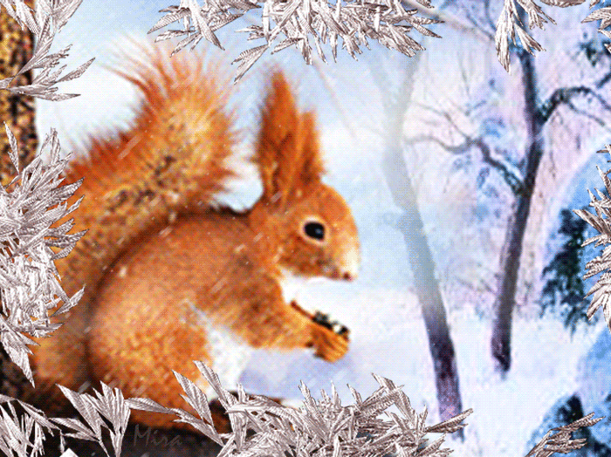

Qq
[kw]
Quick! The squirrel with a queen’s crown is in a
twig.

Slide 20
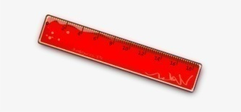
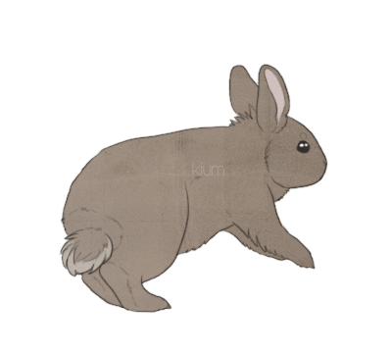
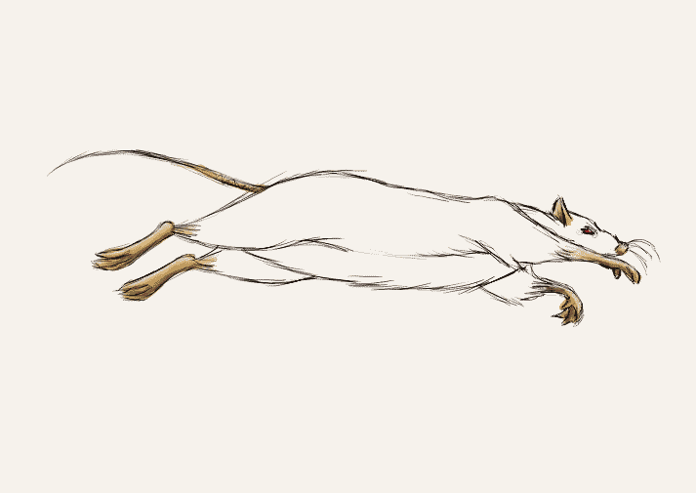
Rr
[r]
The rabbit with a red ruler runs after the rat.

Slide 21
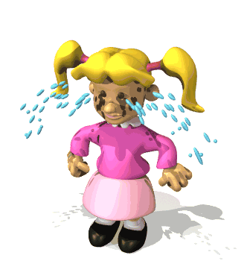
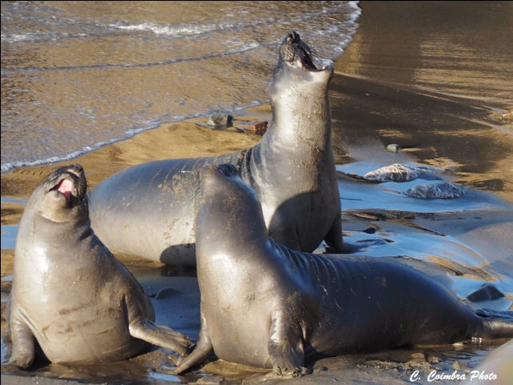

Ss
[s]
Seven seals in the sea sing
the song for you and me.
[z]
It isn’t easy to please
Lizzy.

Slide 22
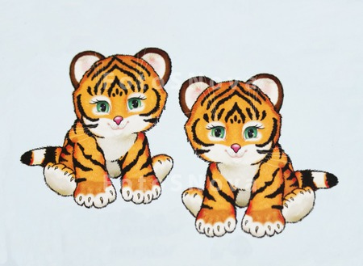

Tt
[t]
Two tiny tigers take two taxis to town.

Slide 23
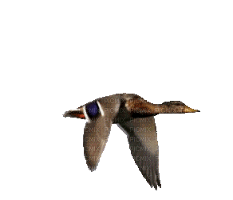


Uu
[ju:]
I don’t like usual tunes in
music.
[ʌ]
My uncle hunts ducks
with a gun.
As snug as a bug in the
rug.

Slide 24

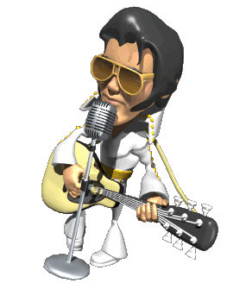
Vv
[v]
Vocalist Victor’s voice is very vocal.

Slide 25
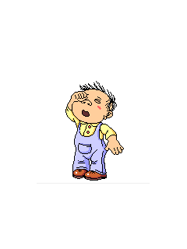
Ww
[w]
Why do you cry, Willy?
Why do you cry?
Why, Willy? Why, Willy?
Why, Willy, why?

Slide 26
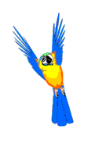
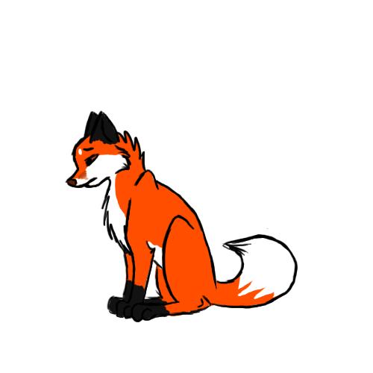
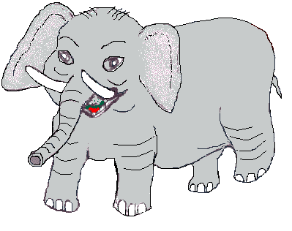


Xx
[ks]
I see two funny foxes
With two small boxes.
[gz]
An examiner gave the
examples of exotic
animals.

Slide 27


Yy
[j]
Every year we ride on
your yellow yacht in New
York.
[i]
I’m busy, busy, busy
Says a little noisy bee
Pretty little noisy bee
Bring some honey for my
tea.

Slide 28
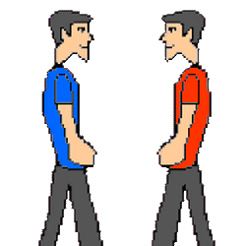
Yy
[ai]
Why did you cry?
I had a fight with that guy.
He tried to bite me,
But I hit him in the eye.

Slide 29
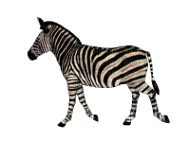
Zz
[z]
Zebras zig and zebras zag.

Slide 30


[ə]
The batter with the butter is the batter that is
better.

Slide 31
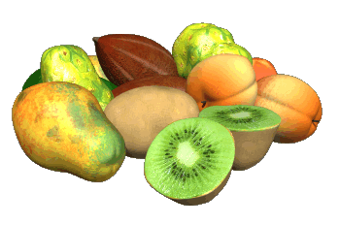
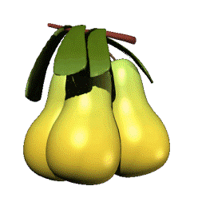



Part II long vowels
[u:]
Fruit is the best food.
Eat your soup with the spoon.

Slide 32
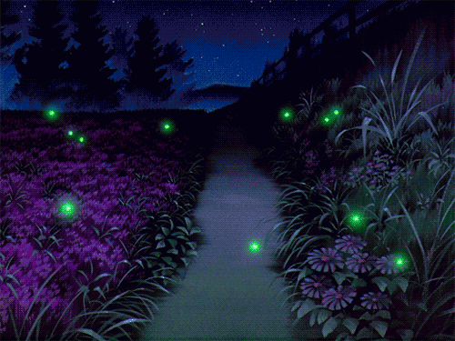
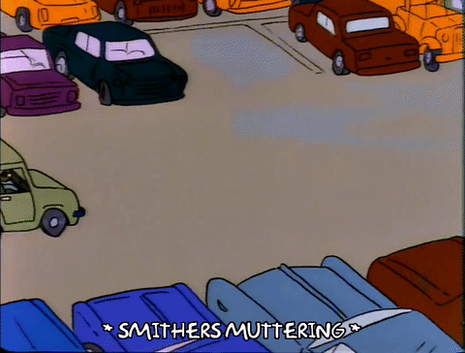
[a:]
A large part of the park
was dark.
Mark parks his car in a car
park.

Slide 33
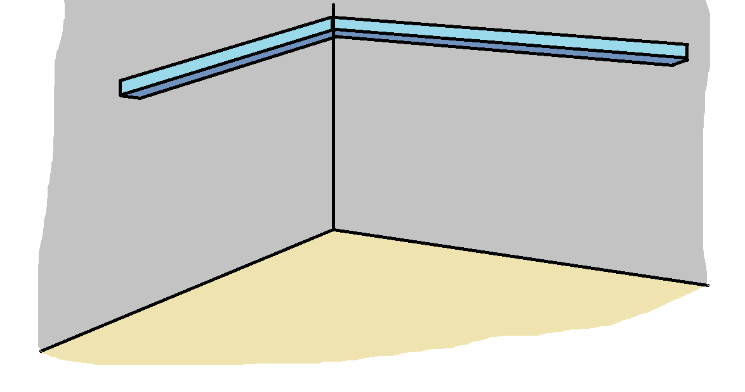

[ɔ:]
The ball is in the corner of the hall.

Slide 34
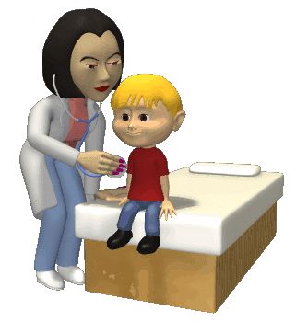
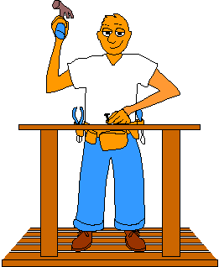
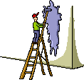

[ə:]
The girl works as a nurse.
The workers were at work.

Slide 35
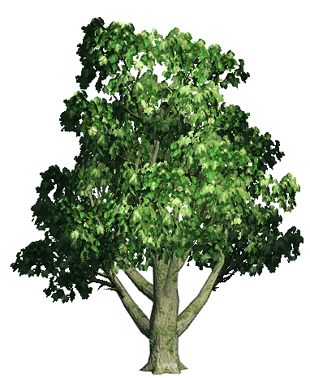



[i:]
Three sheep eat green leaves under the trees.

Slide 36


Diphthong
[ou]
The crow is flying slowly over the snowy road.

Slide 37



Diphthong
[au]
The clowns came down to the town.

Slide 38





Diphthong
[ɔi]
What noise annoys an oyster most?
A noisy noise annoys an oyster most.
The boy enjoys noisy toys.

Slide 39


Diphthong
[ei]
They say they sale stainless nails.
Rain, rain, go away,
Come again another day.
Little Johnny wants to play,
Rain, rain, go away.

Slide 40


Diphthong
[eə]
I don’t care if I live upstairs or downstairs there.

Slide 41


Diphthong
[iə]
The sky is clear here.
He hears with his ears.

Slide 42


Diphthong
[uə]
The tourist took a tour to London.

Slide 43
Diphthong
[ai]
Smile a while and while you smile, others
will smile and then there’ll be miles of smiles.

Slide 44



sh
[ʃ]
She sells sea shells on the sea shore.
She has finished washing the dishes.

Slide 45






ch
[tʃ]
Rachel teaches Chinese to children.
Mitchell had some cheese and chips with
ketchup for lunch.

Slide 46




ph
[f]
Philip collects the photos of elephants and
dolphins.

Slide 47



th
[θ]
Thirty three thousand
people think that Thursday
is their thirtieth birthday.
[ð]
Mother, father, sister,
brother hand in hand
with one another.

Slide 48


ng
[ŋ]
The singer was singing and the ringer was
ringing.

